Slide 1
Simple Web-Based Chat App
BuzzTalk
Dhairya Pandey, Anuj Chaudhary, Vishal Singh
G.L.A. University
Computer Science And Technology
28/Nov/2023

Slide 2
Introduction
In our project, users can connect to the chat room by Creating their Account, send and receive messages in real time, and potentially interact with other users present in the same chat room. WebSocket allows for efficient and low-latency communication, providing a smooth and responsive user experience.
Creating a chat application with WebSocket as it involves understanding real-time communication protocols, handling events, and managing user interactions. It's a practical way to improve one's skills in web development and network programming
Audience can expect a real-time, user-friendly chat experience with multiple chat rooms, and a responsive design for seamless communication.

Slide 3
Objectives
The objectives of our mini project are to create a web-based chatting application that enables real-time communication through WebSocket. The application should support multiple chat rooms, provide an intuitive user interface, maintain responsiveness across devices, include a notification system.
The aim of our project is to develop a web-based chatting application that provides users with a seamless and engaging real-time communication experience. The key goals include supporting multiple chat rooms, creating an intuitive user interface, maintaining responsiveness across devices, incorporating a notification system. Overall, the objective is to deliver a user-friendly platform for effective and secure online communication.

Slide 4
Problem Statement
The problem being addressed by our project is the need for a real-time communication platform that fosters seamless and secure online conversations. Traditional web applications often rely on manual updates, resulting in delays and a less interactive user experience.
The aim is to overcome these limitations by leveraging WebSocket technology to enable instant message exchange, multiple chat rooms, and additional features that enhance the overall quality and responsiveness of online communication.
It is important and relevant in today's digital era as it meets the expectations of users for real-time communication, promotes efficient collaboration, enhances user engagement, supports diverse conversations, addresses security and privacy concerns, and ensures adaptability across devices.

Slide 5
Literature Review
Popular Messaging Apps: Platforms like WhatsApp, Telegram, and Slack serve as benchmarks in the domain of real-time messaging. They often feature group chat capabilities, multimedia sharing, and a user-friendly interface.
Gaming Chat Applications: Gaming platforms often include real-time chat features to facilitate communication among players during gameplay. Discord is a notable example widely used in the gaming community.
Our project fills a gap by offering a real-time communication platform that goes beyond basic messaging. It provides users with a more dynamic and Responsive experience, addressing issues related to delays, organization of conversations.

Slide 6
Methodology
Frontend:
HTML/CSS/JavaScript: HTML for structuring the content, CSS for styling, and JavaScript for dynamic behavior and interactions.
WebSocket Client: Used JavaScript to create a WebSocket client on the frontend. This client establishes a connection with the WebSocket server to enable real-time bidirectional communication.
User Interface: Designed an intuitive and user-friendly interface for users to send and receive messages, join chat rooms.
Backend:
Node.js: Chose Node.js as the backend runtime. It's known for its asynchronous, event-driven architecture, making it well-suited for handling multiple concurrent WebSocket connections.
WebSocket Server: Implemented a WebSocket server using Node.js, which manages incoming connections, facilitates real-time communication, and handles events such as message broadcasting.
Real-Time Message Handling: Implemented mechanisms to handle real-time message sending and receiving, updating the chat interface dynamically as new messages arrive.

Slide 7
System Architecture
Overall Communication Flow:
User Input: Users enter their name in the input form on the webpage.
WebSocket Connection: JavaScript on the frontend establishes a WebSocket connection with the server using the user's name.
User Joining: The server adds the user to the chatroom and broadcasts a system message indicating the user has joined.
Real-Time Communication: Users can send and receive messages in real time within the single chatroom.
User Leaving: When a user closes the browser or leaves the page, the server handles the disconnection event and updates the user list accordingly.
Frontend Interaction Flow:
User Enters Name: User enters their name in the input form on the webpage.
Join Chatroom: User clicks the "Join Chatroom" button.

Slide 8
System Architecture
WebSocket Connection: JavaScript establishes a WebSocket connection with the server, sending the user's name.
User Joins Chatroom: The server adds the user to the chatroom and broadcasts a system message indicating the user has joined.
Real-Time Communication: Users can send and receive messages in real time within the single chatroom.
User Leaves Chatroom: If the user closes the browser or leaves the page, the WebSocket connection is closed, and the server handles the disconnection event.
Backend Interaction Flow:
WebSocket Connection (Server Side): Listens for incoming WebSocket connections from clients.
User Joins Chatroom: Adds the user to the chatroom and broadcasts a system message to notify others about the new user.
Real-Time Communication: Handles incoming messages from one user and broadcasts them to all connected users in the chatroom.
User Leaves Chatroom: If a user disconnects, removes the user from the chatroom and broadcasts a system message about the user leaving.

Slide 9
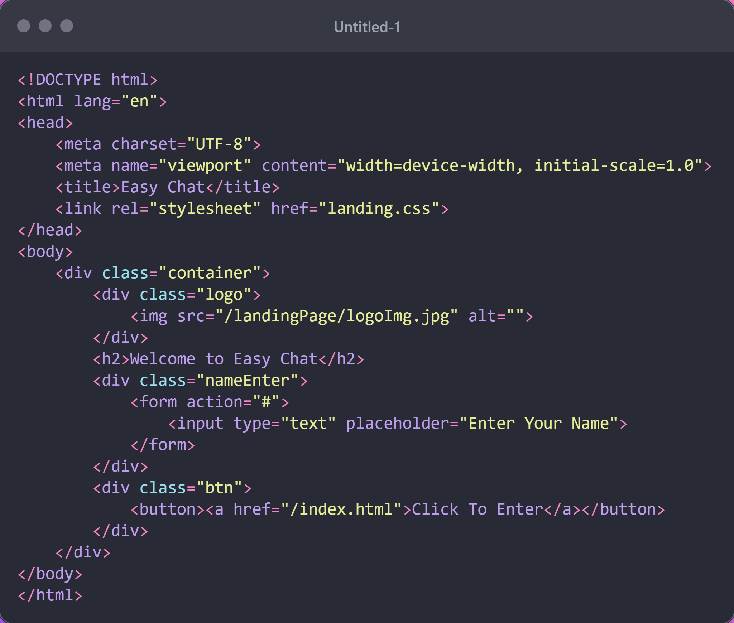
Implementation
User Landing Page Code:
This is the Code Where User Enter their names and join the chatroom

Slide 10
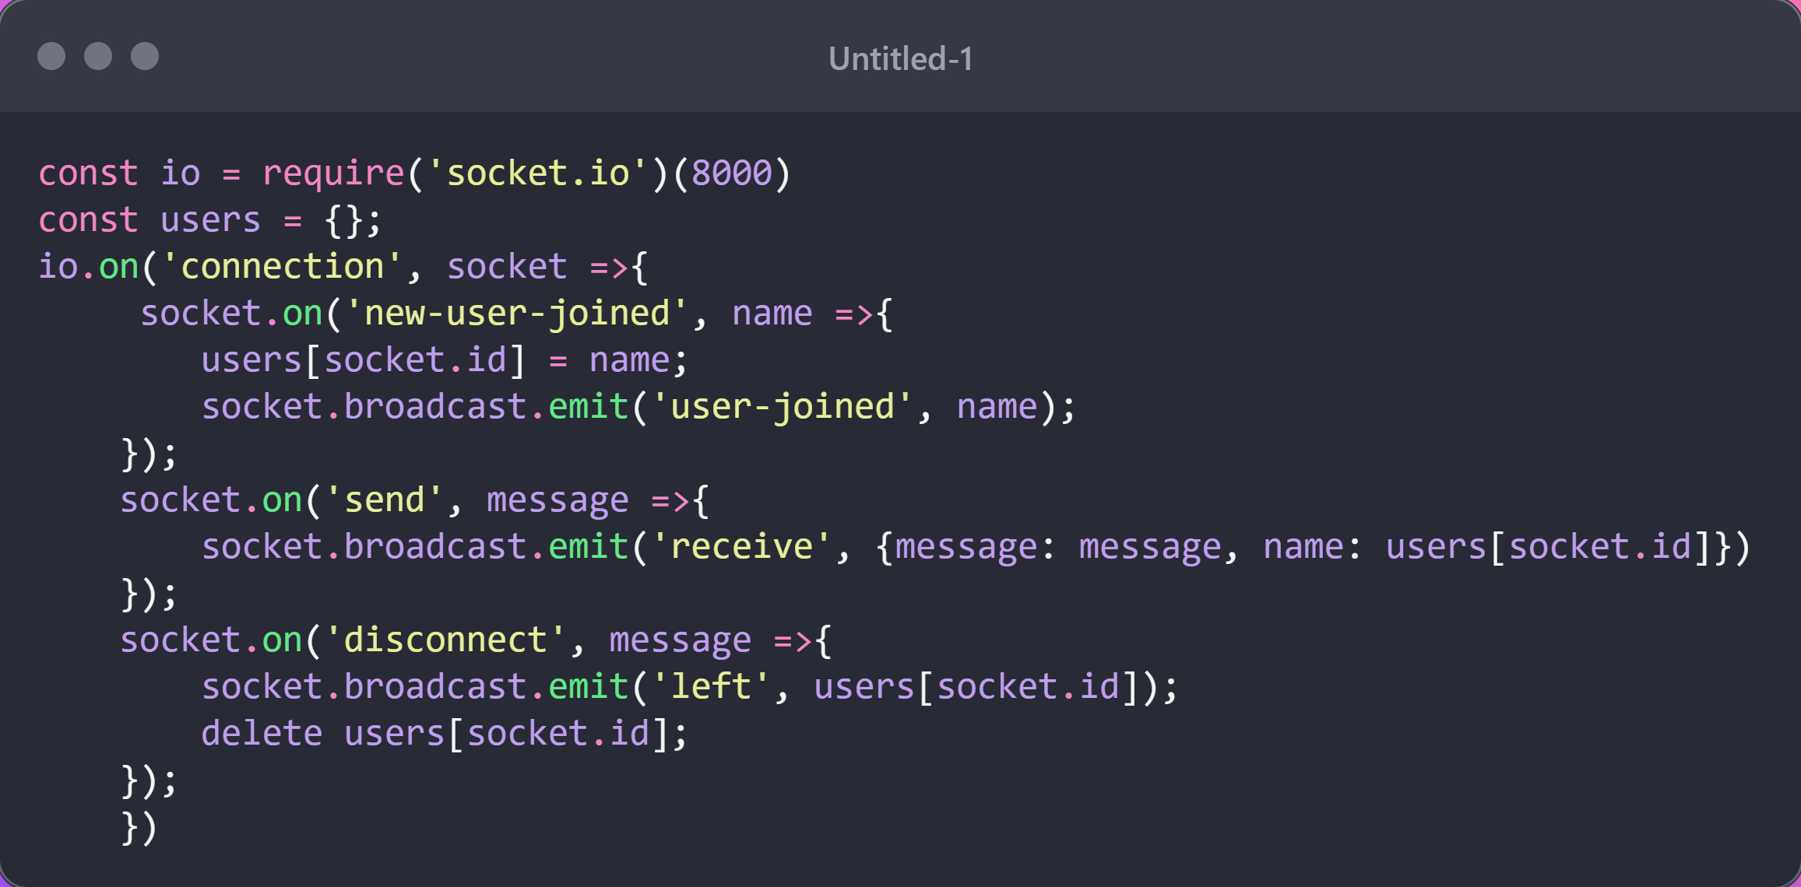
Implementation
Backend Code for Realtime Connection:
This Code Import Websocket Library and rest code works for user
Notification and alert.

Slide 11
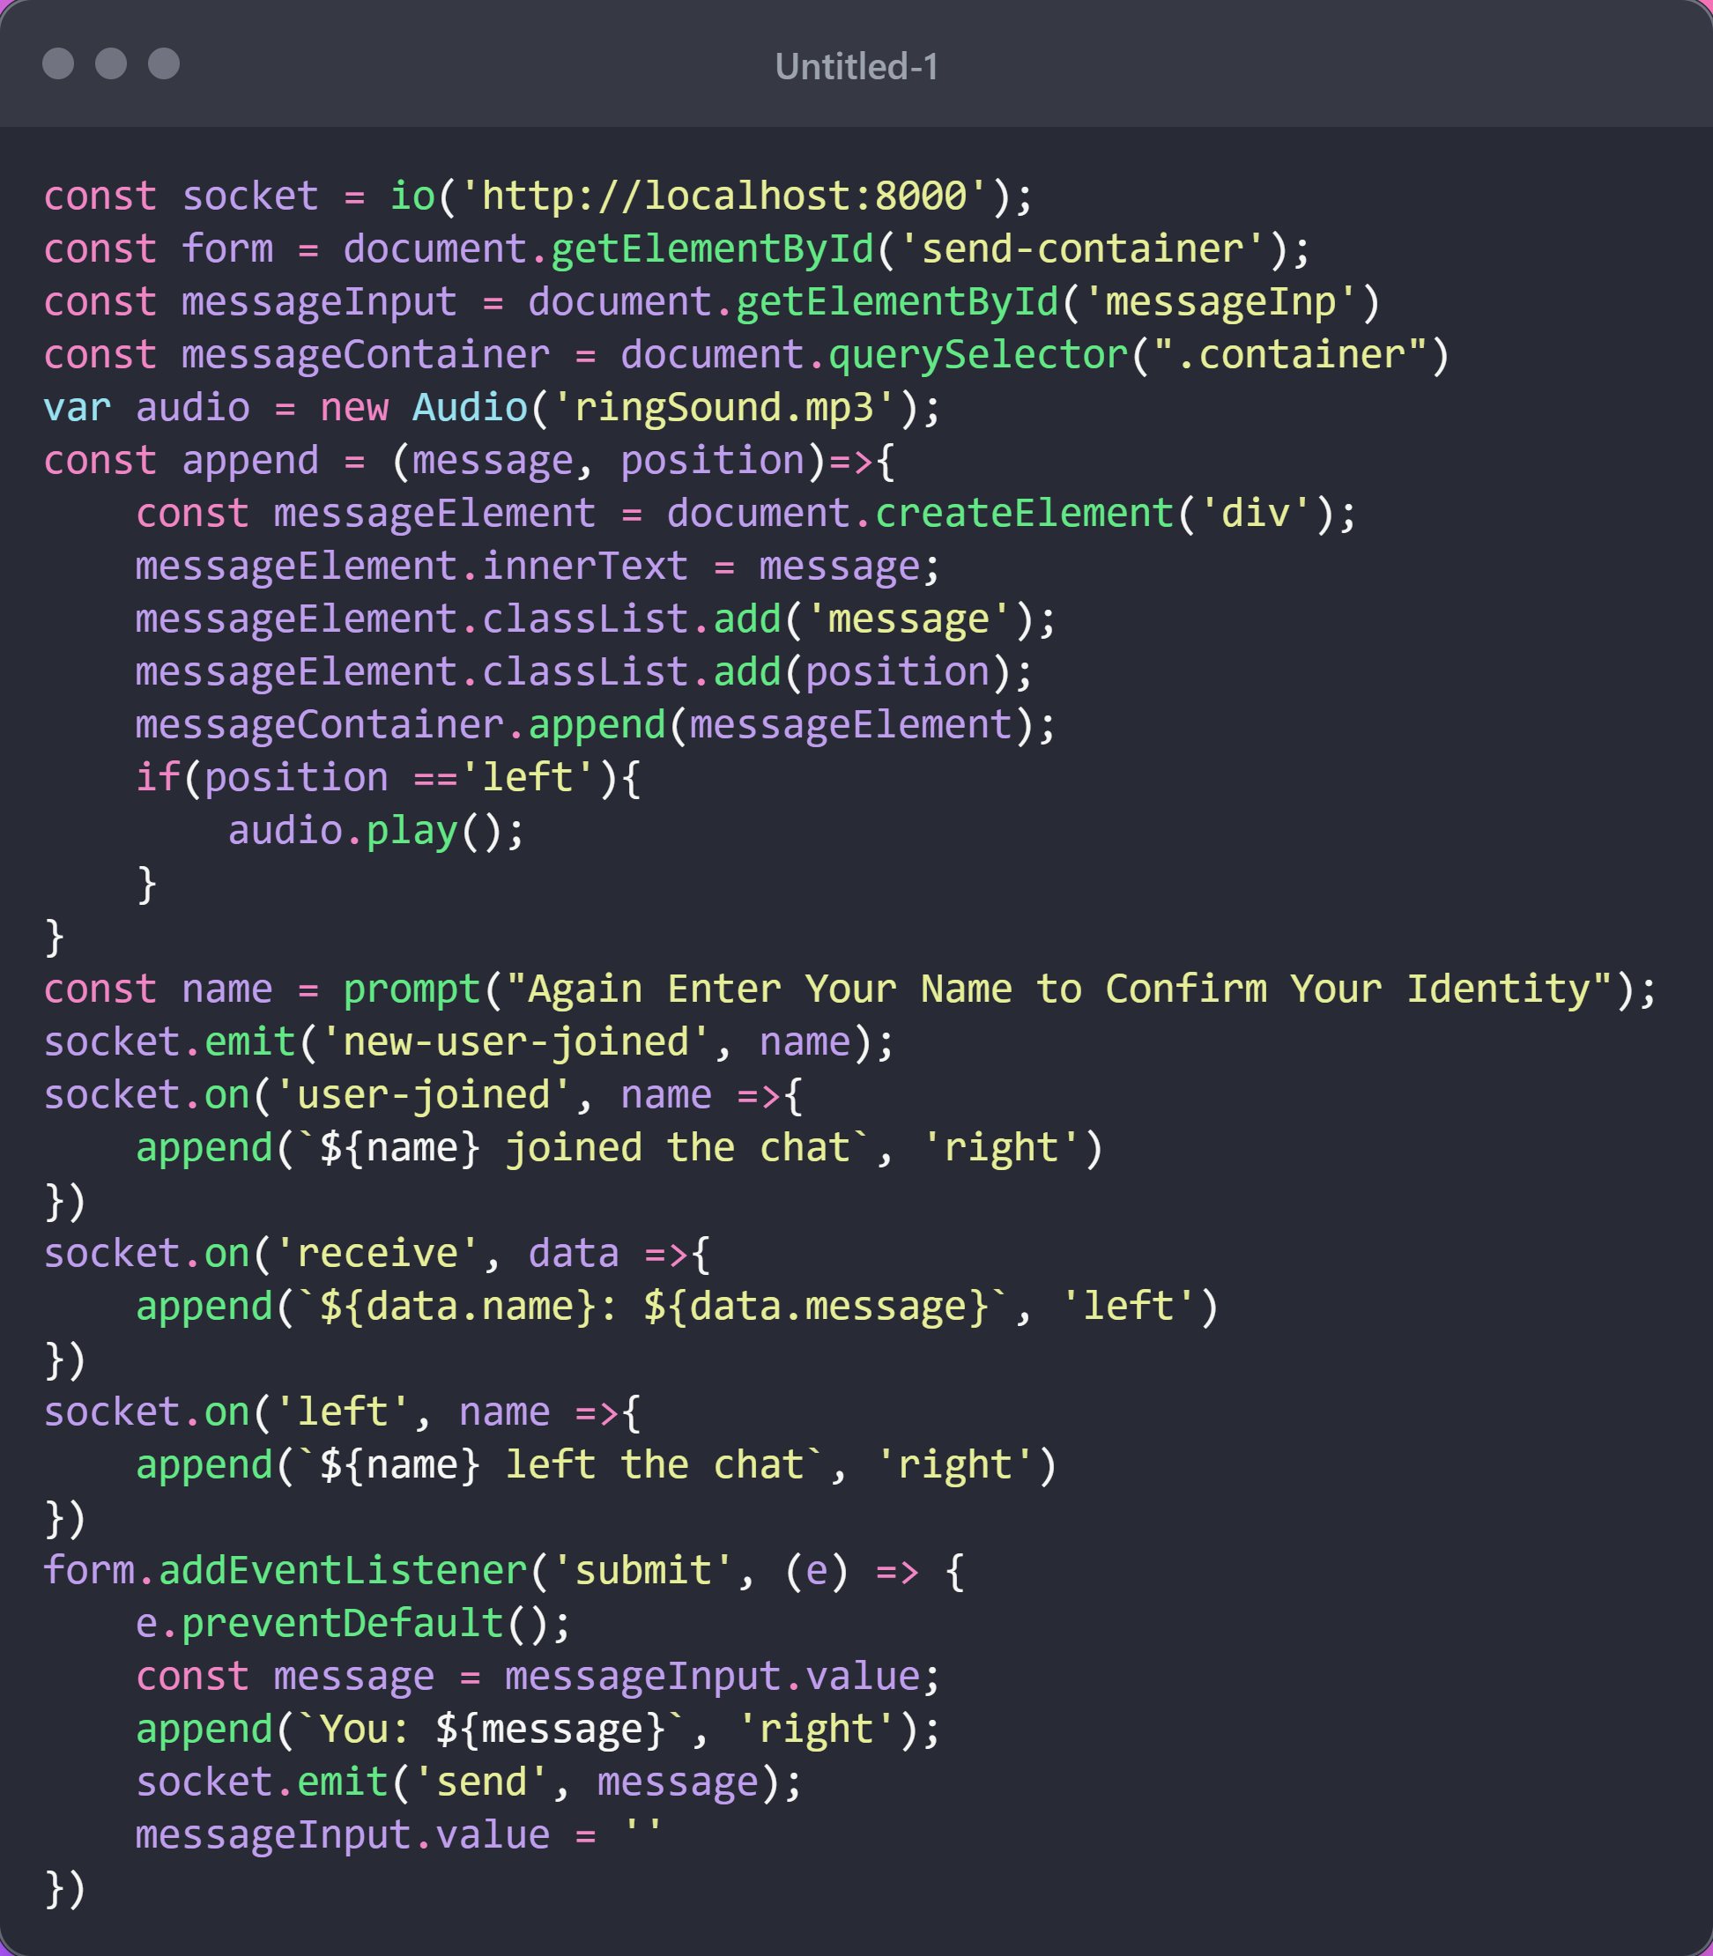
Implementation
User Side JavaScript Code:
This JS Code helps to build connection with Websocket and whenever new user
joins or leaves its logic for that.

Slide 12
Features
The key features of our web-based chatting application may include real-time messaging, User Registration, a simple and intuitive user interface, system messages to inform users about important events, a notification system for updates, responsive design for compatibility across devices, and secure WebSocket connections. These features collectively contribute to a comprehensive and user-friendly chatting experience.

Slide 13
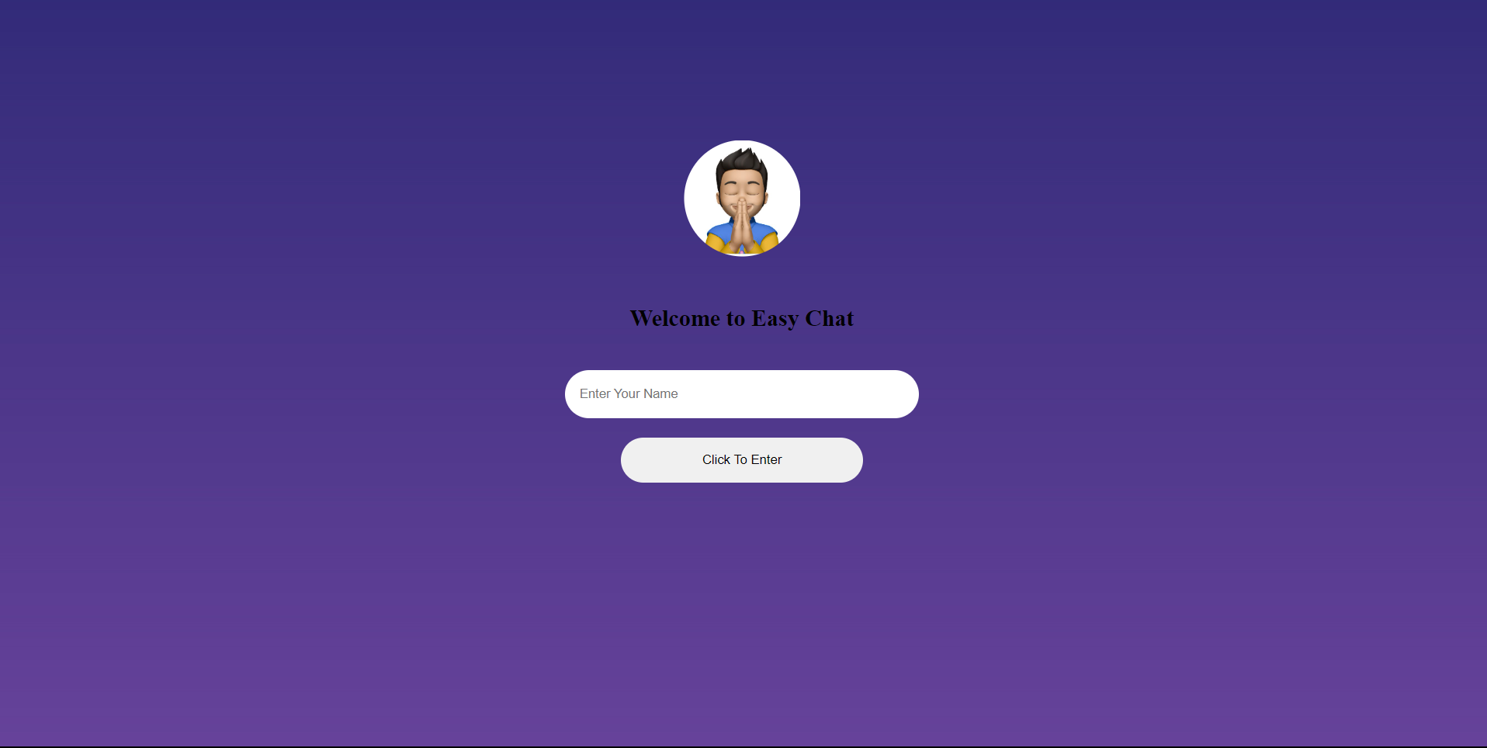
Results
User Landing Page:

Slide 14
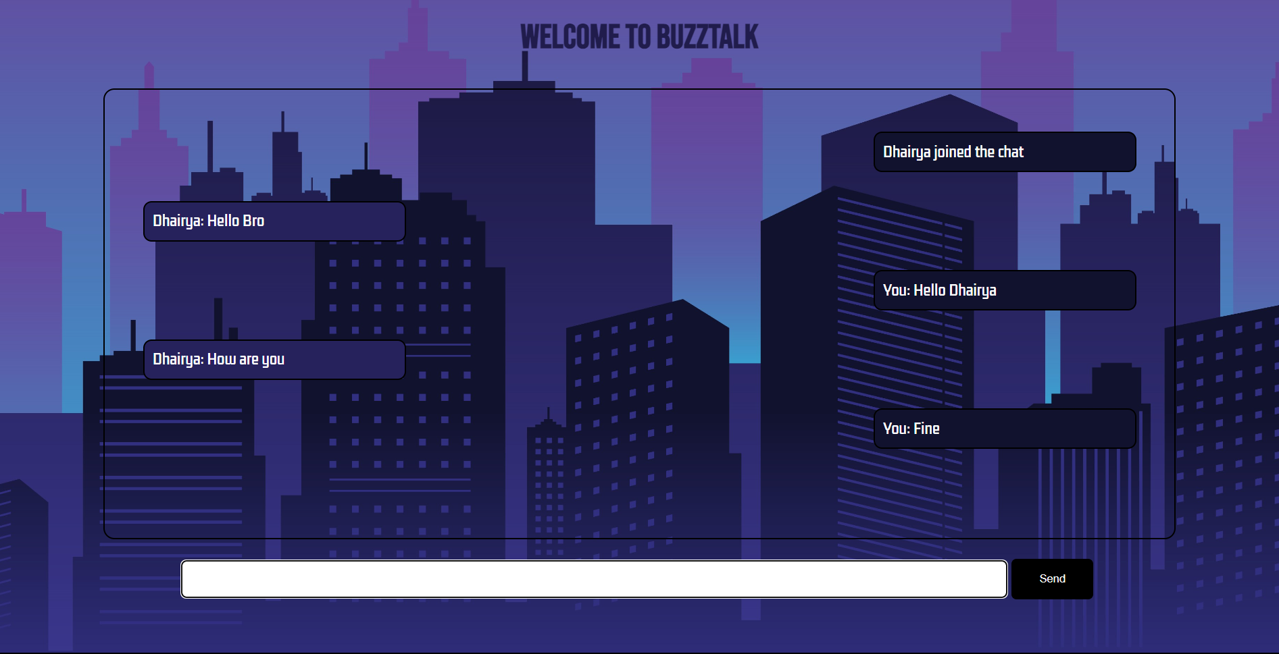
Results
Chatroom For User:

Slide 15
Challenges Faced
User Experience Design:
Challenge: Designing an intuitive and user-friendly interface can be challenging, especially when incorporating multimedia features.
Solution: Conducting user testing, gathering feedback, and iteratively improving the user interface based on user experience.
WebSocket Handling:
Challenge: Managing WebSocket connections and handling events efficiently can be complex.
Solution: Ensuring proper handling of WebSocket connections and implementing robust event management logic.

Slide 16
Future Work
File Sharing: Enable users to share files, documents, and other attachments within the chat.
Emojis and Reactions: Integrate emoji support and reaction features to make conversations more expressive and engaging.
User Profiles: Create user profiles with avatars, status messages, and additional information to enhance user personalization.

Slide 17
Conclusion
Summary of the Project:
Real-time Messaging: Users can engage in instant conversations, fostering dynamic and responsive interactions.
User-Friendly Interface: A simple and intuitive interface for easy navigation and an enjoyable user experience.
Notification System: Users receive notifications about new messages or mentions even when not actively using the chat.
Significance of the Project:
Meeting User Expectations: Users today expect seamless real-time interactions, and this project fulfills that expectation.
User Engagement: Real-time communication enhances user engagement, contributing to a more interactive and enjoyable experience.
Adaptability Across Devices: The responsive design allows users to access the platform seamlessly from various devices.

Slide 18
Acknowledgments
I would like to extend my sincere gratitude to everyone who contributed to the success of this project. This endeavor wouldn't have been possible without the invaluable support and collaboration of many individuals.
Thanks to Our Project Mentor Mr. Amrendra Singh For Assisting Us.

Slide 19
Q&A
Open the floor for questions from the audience

